Slide 1

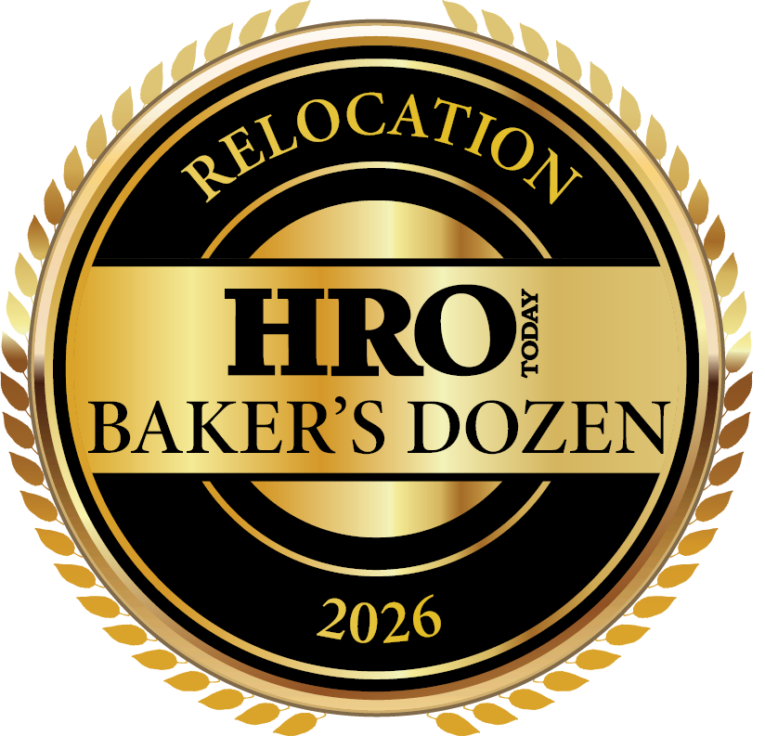
KEY TRENDS
(2022-2026)

Slide 2

Relocation Baker’s Dozen Methodology
HRO Today distributes a survey link to 31 providers and to our own list of approximately 500 Relocation customers each year.
The Baker’s Dozen questionnaire has 37 questions. It measures providers in three dimensions: breadth of services, size of deal, and quality of service.
Companies need a minimum of 13 surveys from 10 companies to qualify for the enterprise list.
The ranking is completely based on customer feedback and quantitative rankings.
Sample Size for Relocation Baker's Dozen Survey
2022-2026*
 | 2022 | 2023 | 2024 | 2025 | 2026
# Respondents | 400 | 300 | 150 | 155 | 151
*Includes responses for providers ranked outside top 13 on the enterprise level

Slide 3
Service Utilization
My company outsources the following employment screening services to this provider:
In 2026, the average number of reported services used was 13.9. This is the second straight year of decline, and lowest in the last five years.
Household goods moving & storage, move management and relocation cost estimates are the five most commonly used services in 2026. The top 5 in 2026 have remained in the top 5 since 2022, albeit in different order.
 | 2022 | 2023 | 2024 | 2025 | 2026
Household goods moving & storage | 91% | 86% | 92% | 92% | 94%
Move management | 78% | 79% | 77% | 74% | 84%
Relocation cost estimates | 78% | 77% | 77% | 75% | 81%
Temporary housing and interim services | 86% | 81% | 76% | 85% | 73%
Relocation program management | 83% | 82% | 77% | 79% | 77%
Most commonly
outsourced service
Second most commonly
outsourced service
Third most commonly
outsourced service
Not top three most
commonly used

Slide 4
Number of Relocations: 2022-2026
This relocation provider helps with the following number of relocations per year:
The distribution of relocations tends towards slightly larger numbers in 2026 over 2025.
  In 2025, 35% of jobs filled were for 1 to 25 relocations per year, down from 2025 (38%).
  Also in 2026, 14% of cases were for 200 or more relocations, up from 12% in 2024.
  There are proportionately fewer smaller relocations of 1 to 25 in 2026 than five years ago, and about the same of larger of 200 or more.

Slide 5
Relationship Type
My organization’s contract with this provider is:
The proportion of contracts vs. project basis decreased in 2026, down eight percentage points to 81% of deals. This returns to the average of 82% between 2022 and 2024 after an increase in 2025.

Slide 6
Contract Renegotiation
Contract renegotiation in 2026 decreased significantly, down to 34% from 47% in 2025.
However, the expansion of the contract during renegotiation increased to 71%, reversing the decline in 2025 and more in line with prior years.
My company has renegotiated the scope of services
under the terms of contract with this provider
In that renegotiation, my company expanded
the scope of services with this provider

Slide 7
Satisfaction Metrics: Trust
Results of three of the satisfaction questions used in the study are included in this trend report.
I trust the executive assigned to my account is among the most crucial elements of satisfaction examined. In 2026, 89% strongly agreed with the statement, the same as 2024 and 2005 . Overall, trust has held steady since 2021.
.

Slide 8
Satisfaction Metrics: Responds Well to Criticism
In 2026, 85% strongly agreed that their provider responds well to criticism and makes changes to improve problem areas, down from 92% in 2025. However, agreement in this area remains high.

Slide 9
Satisfaction Metrics: Overall Satisfaction
In 2026, 92% strongly agreed that overall, they are very satisfied with their provider. Agreement in this area is the highest it has been in the last five years.

Slide 10
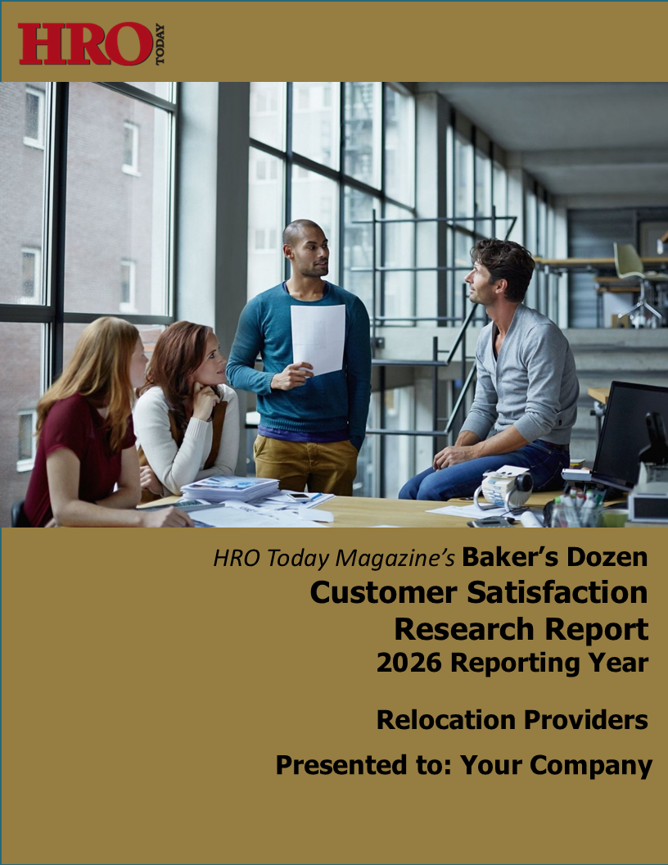
2026 Baker’s Dozen Relocation Services Report
For a comparison of each provider in our survey, along with a complete question-by-question analysis, our detailed research reports are available for purchase.
For more information,
contact Rita Chack at
rita.chack@sharedxpertise.com.

