Slide 1
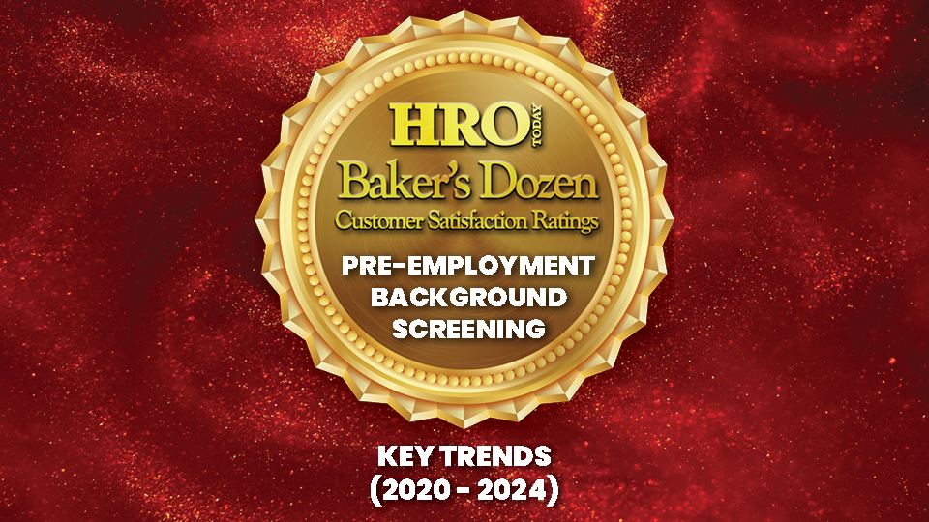

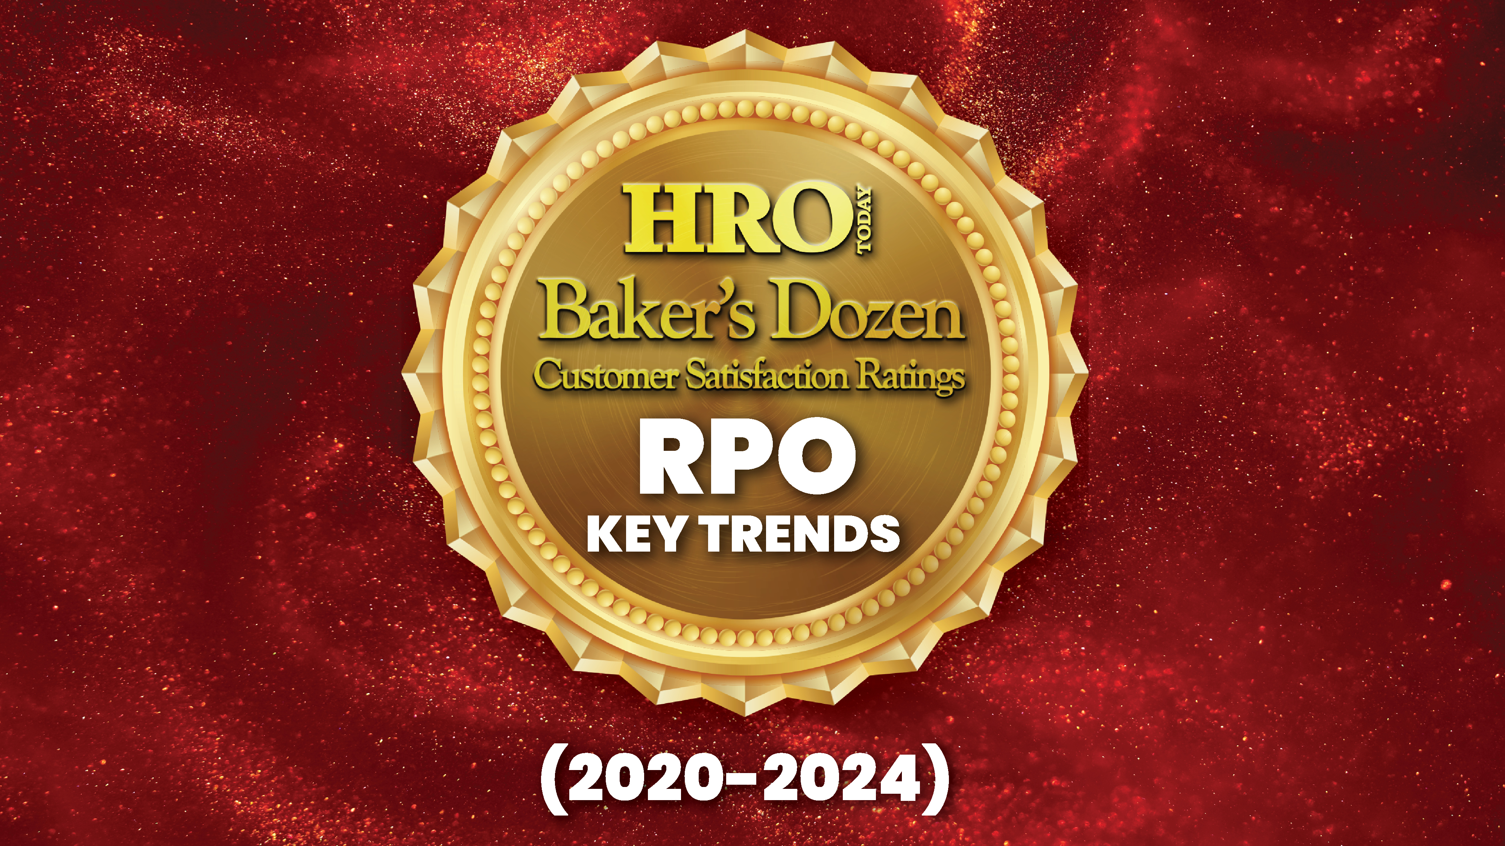
2020-2024
RPO Baker’s Dozen Key Trends
Screening
(2021-2025)

Slide 2
Background Screening Baker’s Dozen Methodology
HRO Today distributes a survey link to about 45 providers and to our own list of approximately 1,500 Background Screening customers each year.
The Baker’s Dozen questionnaire has 40 questions. It measures providers in three dimensions: breadth of services, size of deal, and quality of service.
Companies need a minimum of 13 surveys from 10 companies to qualify for the enterprise list.
The ranking is completely based on customer feedback and quantitative rankings.
Sample Size for Screening Baker's Dozen Survey
2021-2025*
 | 2021 | 2022 | 2023 | 2024 | 2025
# Respondents | 1,200 | 1,000 | 1,200 | 1,100 | 800
*Includes responses for providers ranked outside top 13 Enterprise level

Slide 3
Service Utilization
My company outsources the following employment screening services to this provider
In 2025, the average number of reported services used was 5.3. This marks a stark decline, though the average number of services used has declined since 2022.
Criminal history search, sex offender check, and social security number trace have been the three mostly commonly used services since 2021. Criminal history search is typically the most commonly used service.
 | 2021 | 2022 | 2023 | 2024 | 2025
Criminal history search | 96% | 97% | 97% | 96% | 93%
Sex offender check | 67% | 74% | 81% | 72% | 67%
Social security number trace | 76% | 78% | 80% | 67% | 62%
Most commonly
outsourced service
Second most commonly
outsourced service
Third most commonly
outsourced service

Slide 4
Deal Size: 2021-2025
This screening outsourcing program covers employee lives totaling:
Deal sizes fell again in 2025.
  In 2025, only 10% of jobs filled were for 10,000 or more jobs per year, well below the five-year average level of 23%.
  Two-thirds (66%) of cases were for fewer than 2,000 jobs filled per year in 2025, above the five-year average of 44%.

Slide 5
Relationship Type
This provider provides service primarily on a project, one-year, or multi-year contract basis
Out of the three types of contracts, multi-year, single-year, and project relationships, annual contracts are the most common type of deal at 41%, above the five-year average of 33%. The percentage of multi-year contracts in 2025 (30%) fell from 43% in 2024 and is below the five-year average of 47%.

Slide 6
Contract Renegotiation
Contract renegotiation in 2025 declined to 31% from 46% in 2024. The expansion of the contract during renegotiation declined to 75%, down 11 percentage points from 2024 and the lowest it has been in the last five years.
My company has renegotiated the scope of services
under the terms of contract with this provider
In that renegotiation, my company expanded
the scope of services with this provider

Slide 7
Satisfaction Metrics: Trust
.
Results of three of the satisfaction questions used in the study are included in this trend report.
I trust the executive assigned to my account is among the most crucial elements of satisfaction examined. In 2025, 81% strongly agreed with the statement, up from 2024. Though trust began decreasing in 2020, it has increased over the last two years.

Slide 8
Satisfaction Metrics: Responds Well to Criticism
In 2025, 71% strongly agreed that their provider responds well to criticism and makes changes to improve problem areas. Agreement in this area hit a low in 2024 but has recovered to its normal levels.

Slide 9
Satisfaction Metrics: Overall Satisfaction
In 2025, 80% strongly agreed that overall, they are very satisfied with their provider. Though agreement in this area also hit a low in 2024, it reached its highest level since 2020.

Slide 10
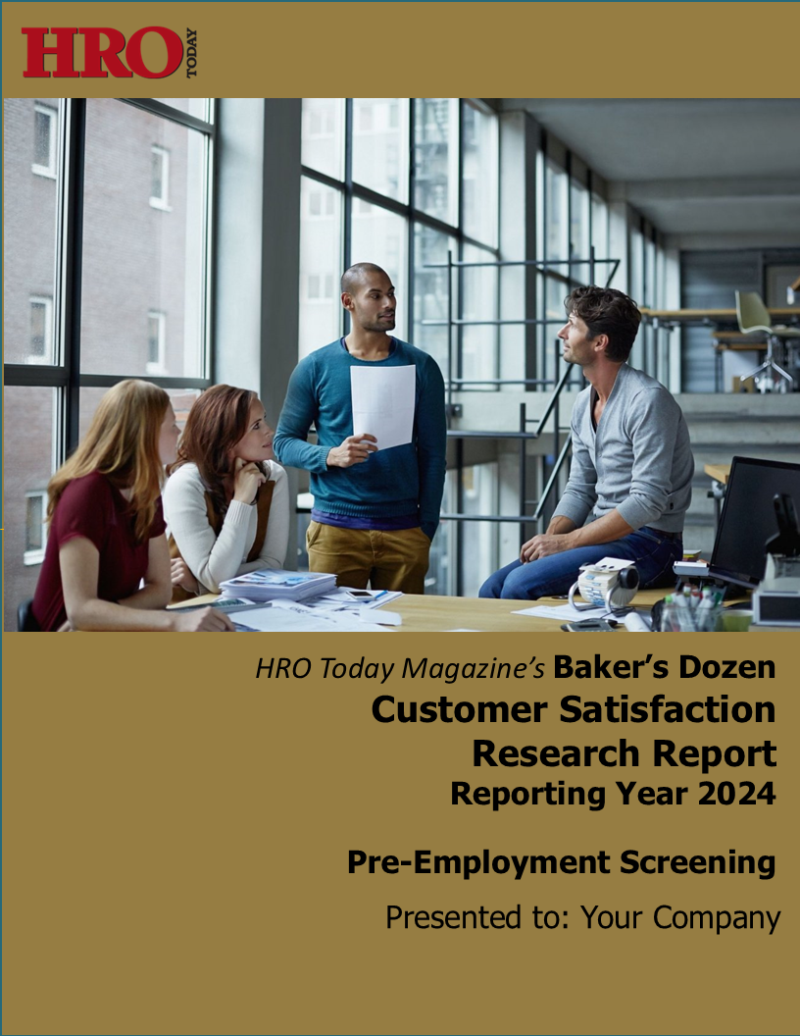
2025 Baker’s Dozen Pre-Employment Background Screening Report
For a comparison of each provider in our survey, along with a complete question-by-question analysis, our detailed research reports are available for purchase.
For more information,
contact Gale Tedeschi at
gale.tedeschi@sharedxpertise.com.

