Slide 1




2020-2024
RPO Baker’s Dozen Key Trends
Recognition
2021-2025

Slide 2
Recognition Baker’s Dozen Summary
Recognition programs are key to employee engagement and to attracting and retaining top talent.
Each year, HRO Today conducts the Baker’s Dozen Customer Satisfaction Survey for Recognition to help HR executives enhance their partnership selection process each year and to provide an overview of top players in recognition and employee rewards and how crucial employee engagement strategy is to retaining top talent.
There are select findings from the Baker’s Dozen Customer Satisfaction Survey for Recognition Providers over the last five years, including the most used services and other metrics.

Slide 3
Recognition Baker’s Dozen Methodology
HRO Today distributes a survey link to about 45 providers and to our own list of approximately 700 Recognition customers each year.
The questionnaire has 30 questions. It measures providers in three dimensions: breadth of services, size of deal, and quality of service.
Companies need a minimum of 13 surveys from 10 companies to qualify to be ranked.
The ranking is completely based on customer feedback and quantitative rankings.
In 2025, there were 233 useable survey respondents.

Slide 4
Service Utilization
My company outsources the following recognition services to this provider
In 2025, the average number of reported services used is 9.3. This percentage has held fairly steady over the last two years since an increase leading up to 2023.
Peer-to-peer recognition capabilities, recognition data capture and reporting, tenure-based recognition services, and reward distribution management have typically been the top four mostly commonly used services since 2020.
 | 2021 | 2022 | 2023 | 2024 | 2025
Peer-to-peer recognition capabilities | 70% | 66% | 67% | 68% | 74%
Recognition data capture and reporting | 59% | 61% | 63% | 64% | 66%
Tenure-based recognition services | 66% | 63% | 64% | 58% | 64%
Reward distribution management | 56% | 61% | 62% | 64% | 62%
Most commonly
outsourced service
Second most commonly
outsourced service
Third most commonly
outsourced service
Fourth or lower most commonly
outsourced service

Slide 5
Deal Size: 2021-2025
This Recognition outsourcing program covers employee lives totaling:
Deal sizes fell in 2025.
  In 2025, 29% of jobs filled were for 20,000 or more jobs per year, down from 32% in 2024.
  Nearly one-half (43%) of cases were for fewer than 5,000 jobs filled per year in 2024, up from 36% in 2024.

Slide 6
Relationship Type
This provider provides service primarily on a project, one-year, or multi-year contract basis
The proportion of all three types of contracts: multi-year, single-year and project relationships favor multi-year deals. The percentage of multi-year contracts in 2025 (66%) increased from 62% in 2024, while the project-based percentage stayed the same (7%).

Slide 7
Contract Renegotiation
Contract renegotiation in 2025 increased to 62% from 58% in 2024, the highest it has been in the last five years. The expansion of the contract during renegotiation increased to 80%, up four percentage points from 2024 and the second highest it has been in the last five years.

Slide 8
Satisfaction Metrics: Trust
Results of three of the satisfaction questions used in the study are included in this trend report.
I trust the executive assigned to my account is among the most crucial elements of satisfaction examined. In 2025, 67% strongly agreed with the statement, about where it has been since 2023 when trust declined.
.

Slide 9
Satisfaction Metrics: Responds Well to Criticism
In 2025, 61% strongly agreed that their provider responds well to criticism and makes changes to improve problem areas. Agreement in this area fell in 2023 and has recovered only minimally.

Slide 10
Satisfaction Metrics: Overall Satisfaction
In 2025, 62% strongly agreed that overall, they are very satisfied with their provider. Agreement in this area fell in 2022 and has not yet recovered to prior levels.

Slide 11
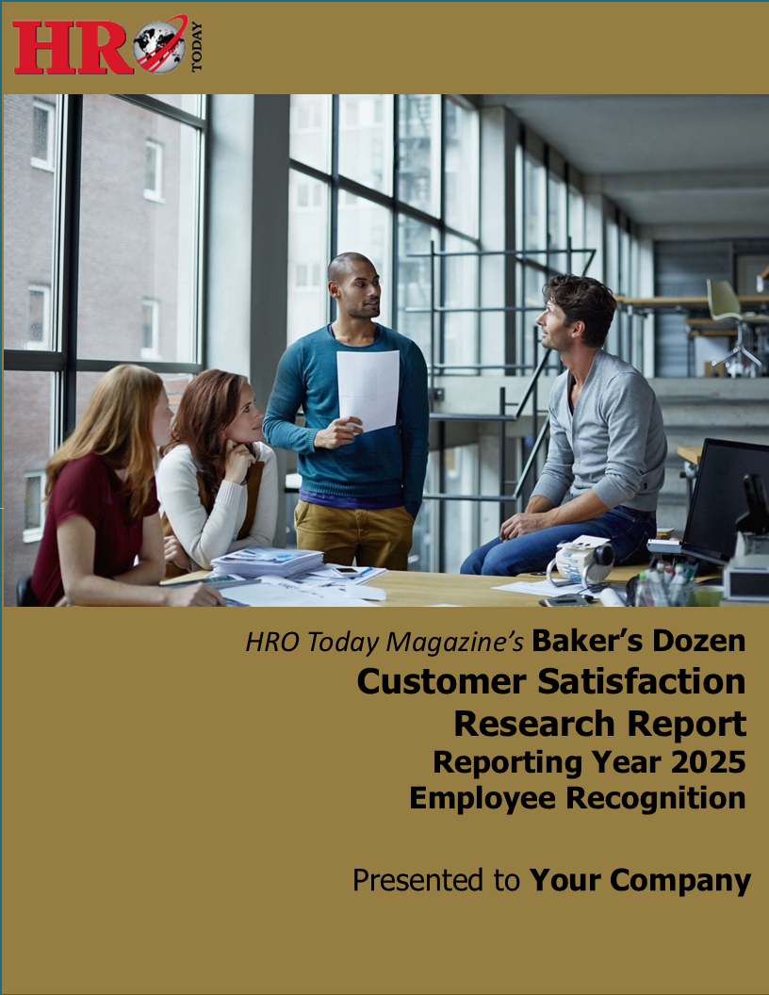
2025 Baker’s Dozen Recognition Report
For a comparison of each provider in our survey, along with a complete question-by-question analysis, our detailed research reports are available for purchase.
For more information,
contact Gale Tedeschi at
gale.tedeschi@sharedxpertise.com.

